Slide 1
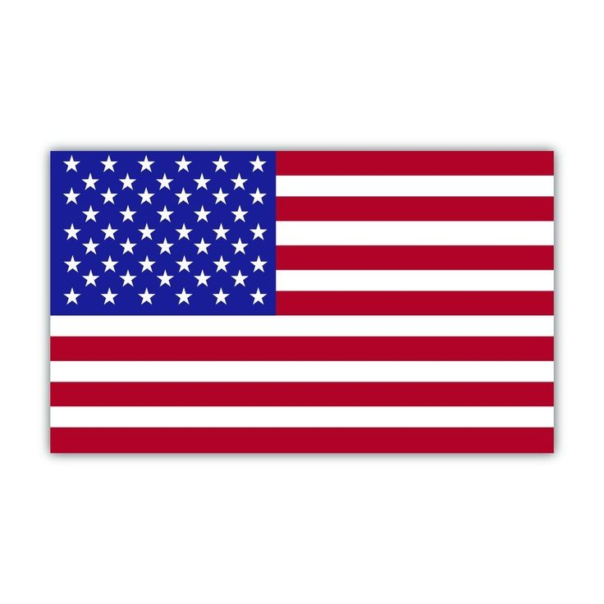
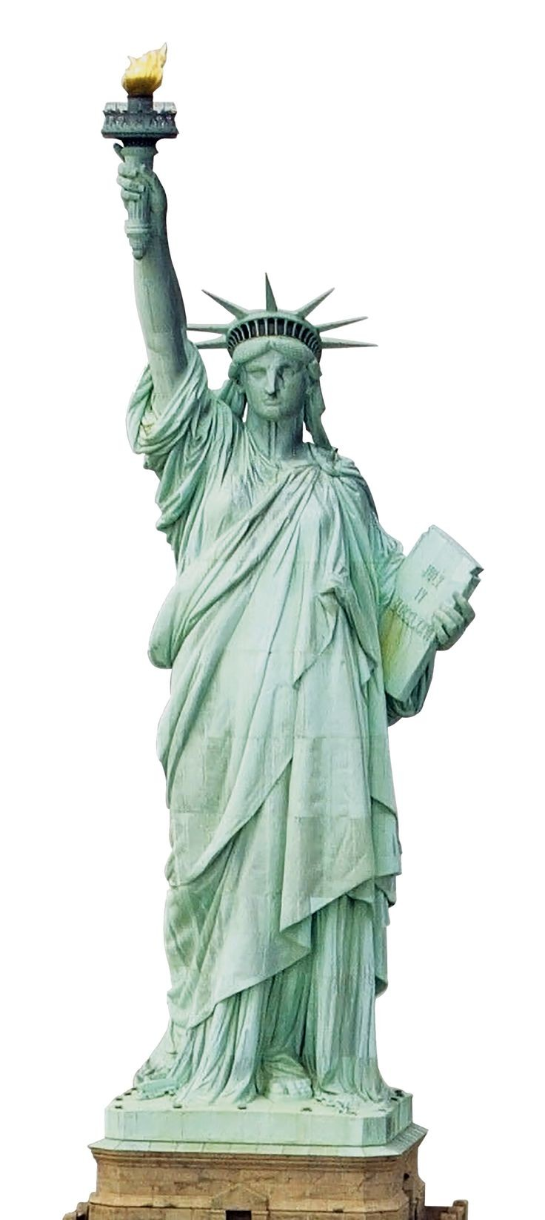
“Normal” Things Americans Do That The Rest Of The World Will Never Understand

Slide 2
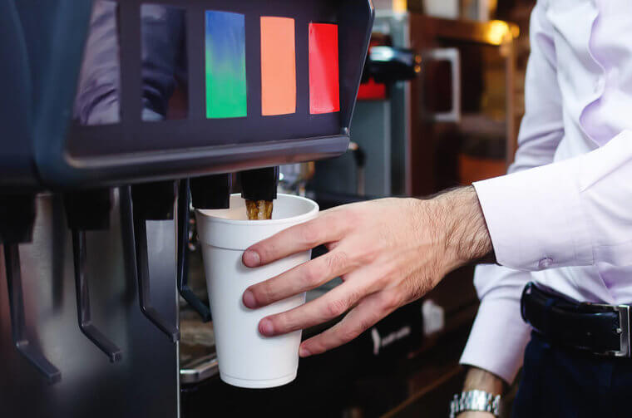
1)Expecting Free Refills.
Here is something pretty familiar in American eateries, although not all. It is usual for some dining establishments to offer their customers free drink refills. As a result, when Americans go abroad, they are in for an annoying surprise when they have to pay for every cup they drink.

Slide 3
2. Using a lot of water in the toilet bowls.
Toilets are undoubtedly different in the US than in other parts of the world. One amusing difference is how much wasted water in American bathrooms than in other countries.
In the Reddit thread, one user wrote, “Seriously, why so much?!”

Slide 4
3)'Soccer' - It's Called Football!
While we can appreciate that Gridiron, also known as American football, is widely popular in the USA, that isn't necessarily the case worldwide.
The majority of people in the world call what Americans know as soccer as football. So,why the Americans call the sport soccer whilst the rest of the world calls it football.

Slide 5
4)Pronouncing the last letter of the alphabet as "zee"
In America, the letter Z is, well, zee.
In most other English-speaking countries—like Canada, Ireland, or England, the letter Z is pronounced zed.
Why the World Pronounces "Z" as "Zed" And Americans Don't

Slide 6
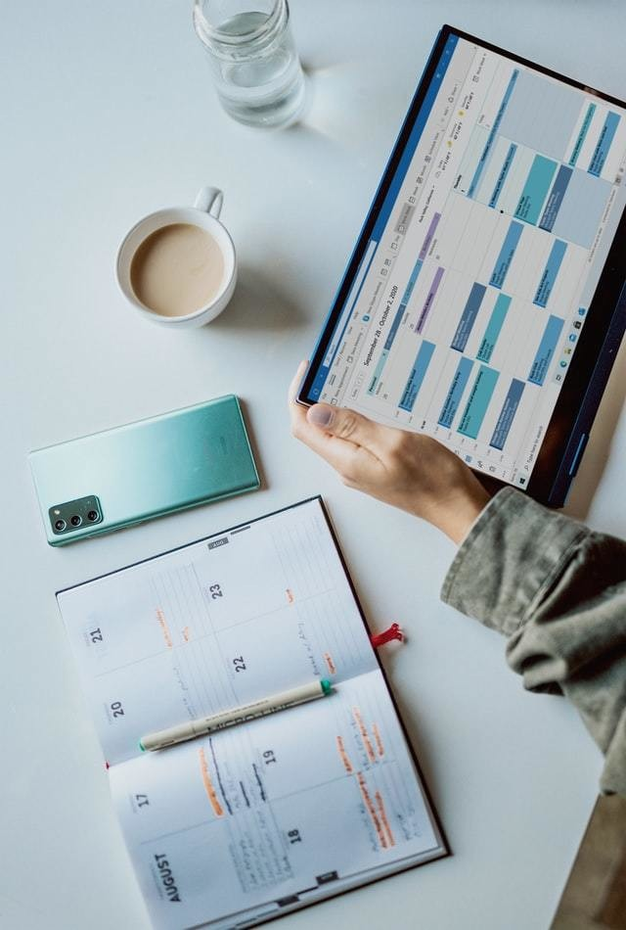
5)The Lack Of Days Off
America is one of the only developed countries in the world where vacation and sick days aren't legally mandated.
Even worse, you often have to break up those vacation days into small intervals instead of just going on a proper three-week vacation.

Slide 7
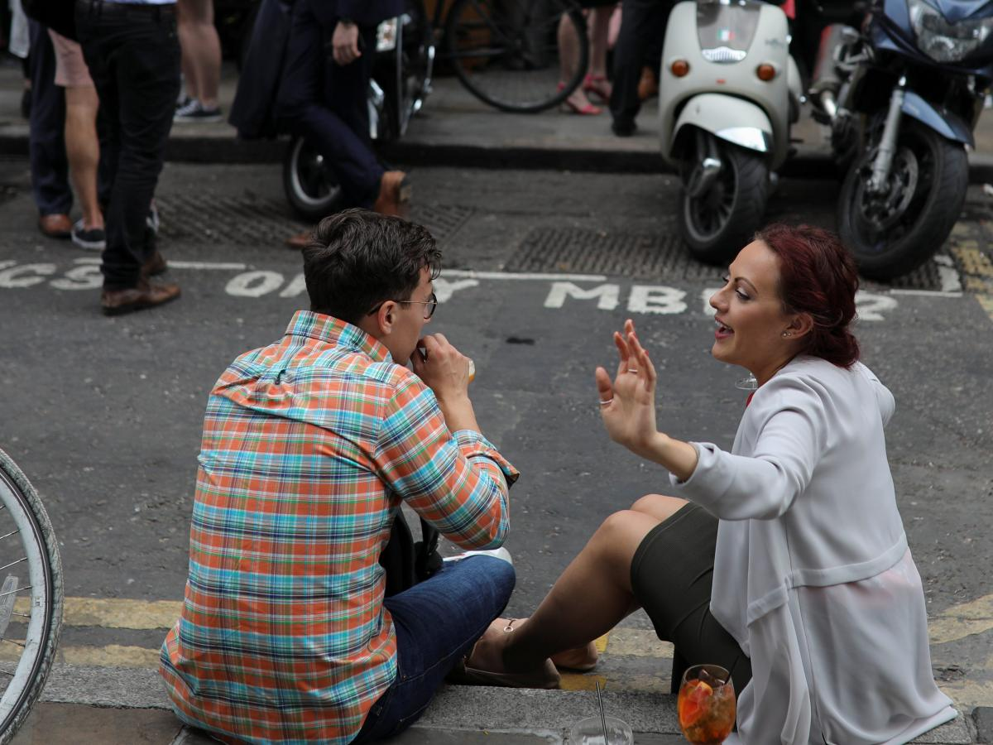
6)Small talk
Small talk is a way for us to feel comfortable with others when we first meet, to address the awkwardness of silence in the initial meeting. We are a culture that dreads silence when in the company of others. Two seconds of silence feels like an eternity. So we talk about non-essential matters to fill up that space.

Slide 8
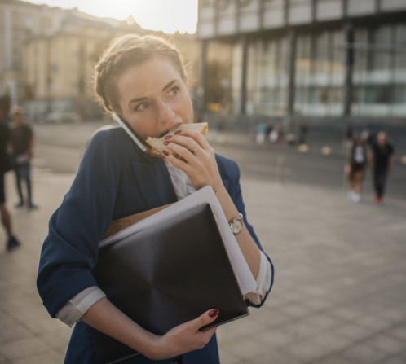
7) « to-go »concept:
Most Americans are always on the go. It seems they are often running from one appointment to the next. Because Americans are regularly on the move, there is often not enough time to have a formal, sit-down meal. A common expression you’ll hear is, “24 hours in a day is not enough!”

Slide 9
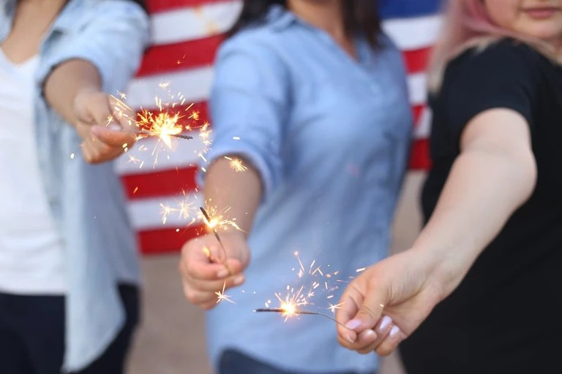
8-celebreting the fourth of july:
Declaration of Independence July 4th, 1776 granted the United States freedom from the British Empire. Celebration is with parades, cookouts, concerts, and most notably, fireworks. It is a federal holiday where many display American flags and dress in red, white, and blue to honor the flag's colors. Some even incorporate the colors into holiday food, drinks, and decor.

